Slide 1
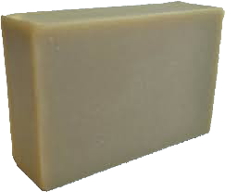
BUBBLE BLISS
Kyrylo Vlasenko Matsvei Haidukou
Volodymyr Kalinin

Slide 2
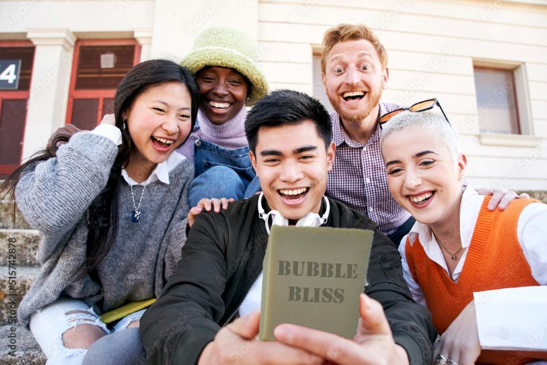
cleaning soap
Brand new

Slide 3
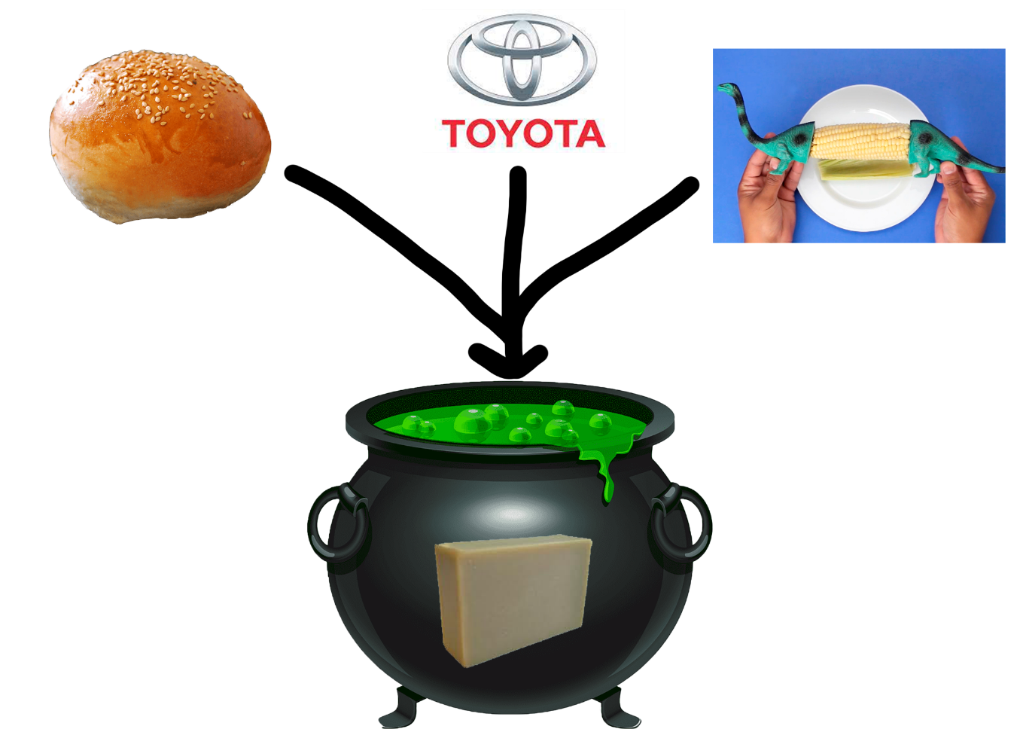
natural ingredients

Slide 4
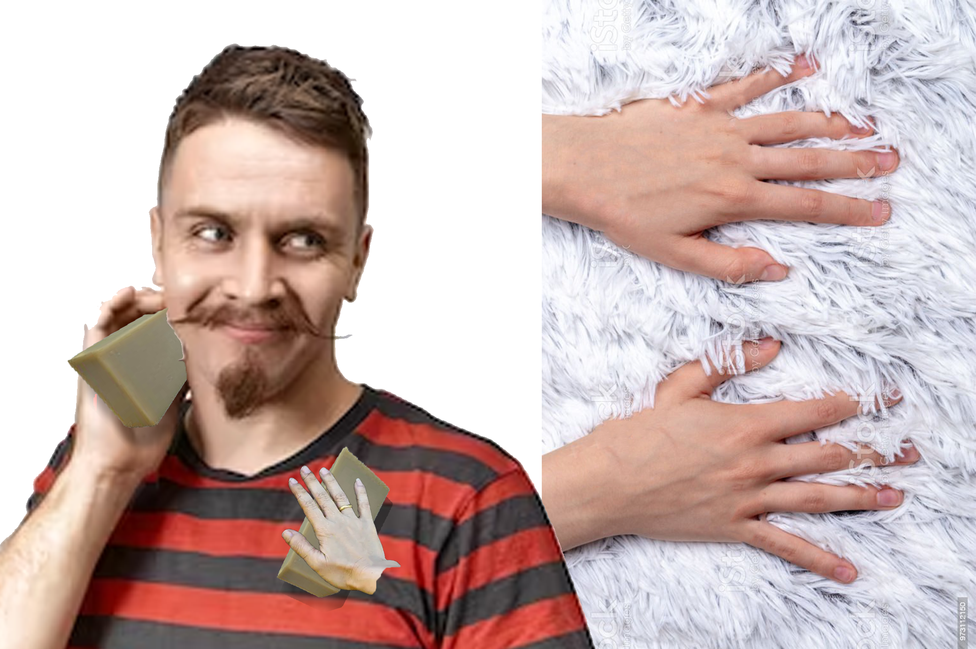
Incredible pleasure during and after use

Slide 5
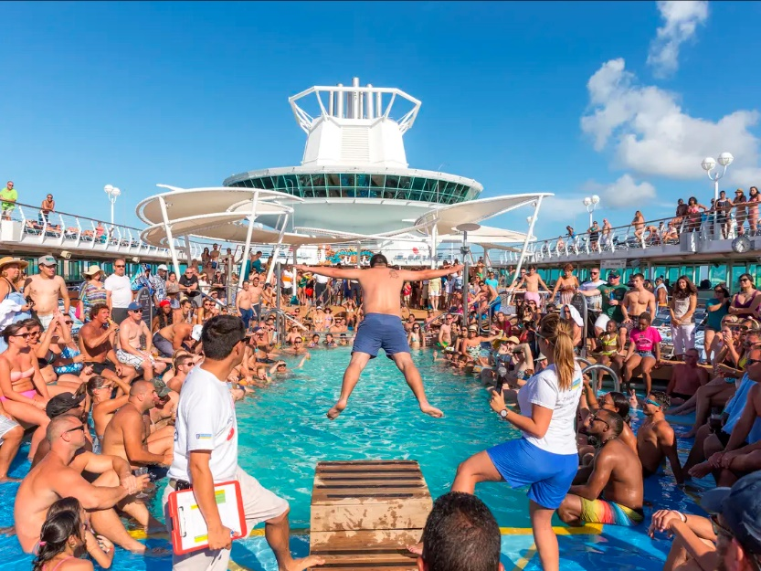
Tempting Grand Prize

Slide 6
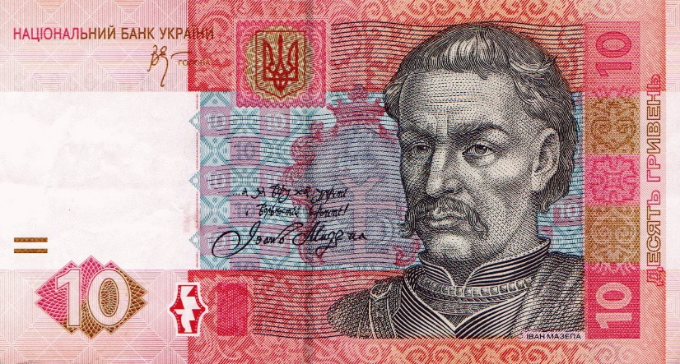
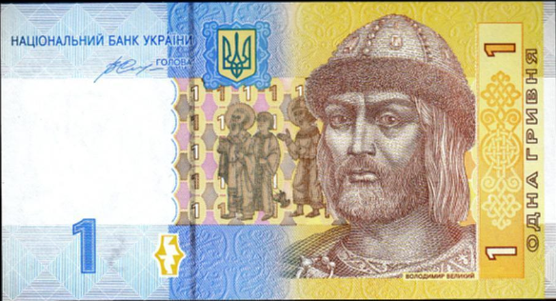
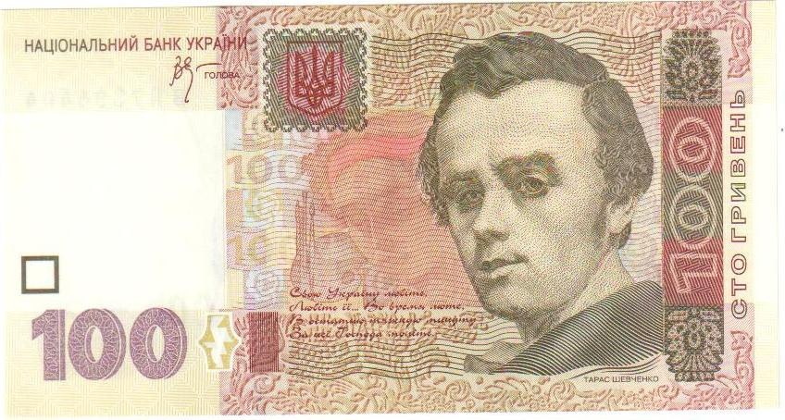
No less Satisfying consolation prizes

Slide 7
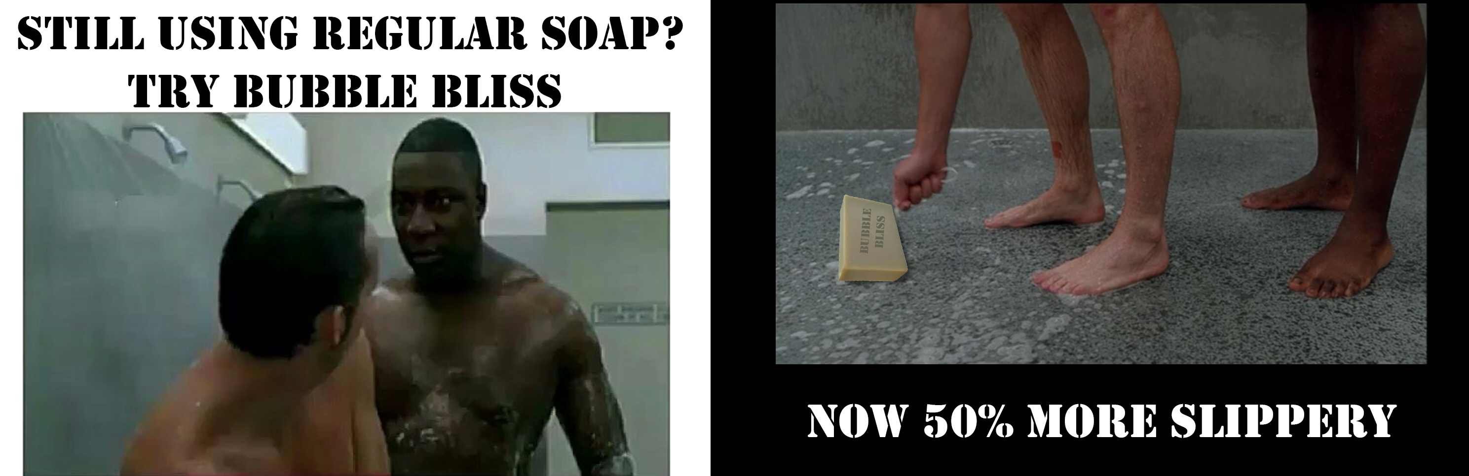
Buy our soap

Slide 8


